Slide 1
Portfolio Recommendation for Long-Term Growth
Achieving Kids' College Fees Goal for Anita
Dhaval Padhiyar

Slide 2
Understanding Your Goals
Key Details
Client Name: Anita
Age: 35 years
Total Savings: ₹20,00,000
Stocks Investment: ₹10,00,000
Primary Goal: Kids’ college fees
Time Horizon: 20 years
Risk Tolerance: High
Return Target: 28%

Slide 3
Our Approach: Building a Robust Portfolio
We aim to construct a portfolio that aligns with your high-risk objective and long-term goal.
Our process involves:
Diversified Stock Selection: Choosing stocks from various sectors and market capitalizations.
Historical Performance Analysis: Examining returns, volatility, and correlations over different time horizons.
Strategic Stock Selection: Applying market momentum & reversal strategies for potential outperformance.
Portfolio Optimization: Utilizing advanced techniques to find the best allocation of funds for your risk preference.

Slide 4
Selected Stocks: Diversity Across Indian Market
We've conducted an in-depth study of 10 prominent Indian stocks to identify suitable candidates for your long-term growth portfolio.
These stocks represent a range of sectors and market capitalizations to provide diversification and potential for growth
S No | Company | Symbol | Capitalisation | Sector
1 | Kotak Mahindra Bank Ltd. | KOTAKBANK | Large Cap | Financial Services
2 | ITC Ltd | ITC | Large Cap | Fast Moving Consumer Goods
3 | Tata Power Co. Ltd | TATAPOWER | Large Cap | Power
4 | Tata Consultancy Services | TCS | Large Cap | Information Technology
5 | PETRONET LNG LTD. | PETRONET | Mid Cap | Oil Gas & Consumable Fuels
6 | Glenmark Pharmaceuticals ltd | GLENMARK | Mid Cap | Healthcare
7 | Shree Cements Ltd. | SHREECEM | Mid Cap | Construction Materials
8 | Blue Dart Express Ltd. | BLUEDART | Small Cap | Services
9 | BASF India Ltd | BASF | Small Cap | Chemicals
10 | Apollo Tyres Ltd | APOLLOTYRE | Small Cap | Auto

Slide 5
Stock Performance – Short-Term Snapshot (6 Months)
Understanding recent performance helps identify stocks with strong current momentum.
Interpretation: Kotak Mahindra Bank and Shree Cements showed very strong short-term geometric returns, indicating positive recent momentum.
 | Period | Asset | Annual Geo Return (%) | Annual Arith Return (%) | Annual Vol (%) | Annual Sharpe
1 | 6M | KOTAKBANK | 62.70% | 50.97% | 18.35% | 2.51
2 | 6M | SHREECEM | 40.92% | 36.55% | 20.99% | 1.5
3 | 6M | PETRONET | -7.53% | -4.93% | 25.90% | -0.38
4 | 6M | APOLLOTYRE | -12.66% | -4.82% | 44.69% | -0.22
5 | 6M | TCS | -21.44% | -20.91% | 26.20% | -0.99
6 | 6M | ITC. | -21.70% | -21.87% | 23.29% | -1.15

Slide 6
Stock Performance – Long-Term Trends (5 Years)
Analyzing longer periods helps identify stocks that are experiencing "momentum reversal," where strong trends might reverse, or those that have underperformed relative to the market.
Interpretation: Kotak Mahindra Bank, Shree Cements and Petronet have underperformed relative to other stocks
 | Period | Asset | Annual Geo Return (%) | Annual Arith Return (%) | Annual Vol (%) | Annual Sharpe
1 | 5Y | SHREECEM | 8.83% | 11.18% | 23.41% | 0.26
2 | 5Y | KOTAKBANK | 10.29% | 12.90% | 25.40% | 0.31
3 | 5Y | PETRONET | 10.33% | 12.96% | 25.23% | 0.32
4 | 5Y | TCS | 13.16% | 14.66% | 21.49% | 0.45
5 | 5Y | ITC | 23.99% | 24.10% | 22.46% | 0.85
6 | 5Y | APOLLOTYRE | 38.89% | 38.67% | 33.53% | 1

Slide 7
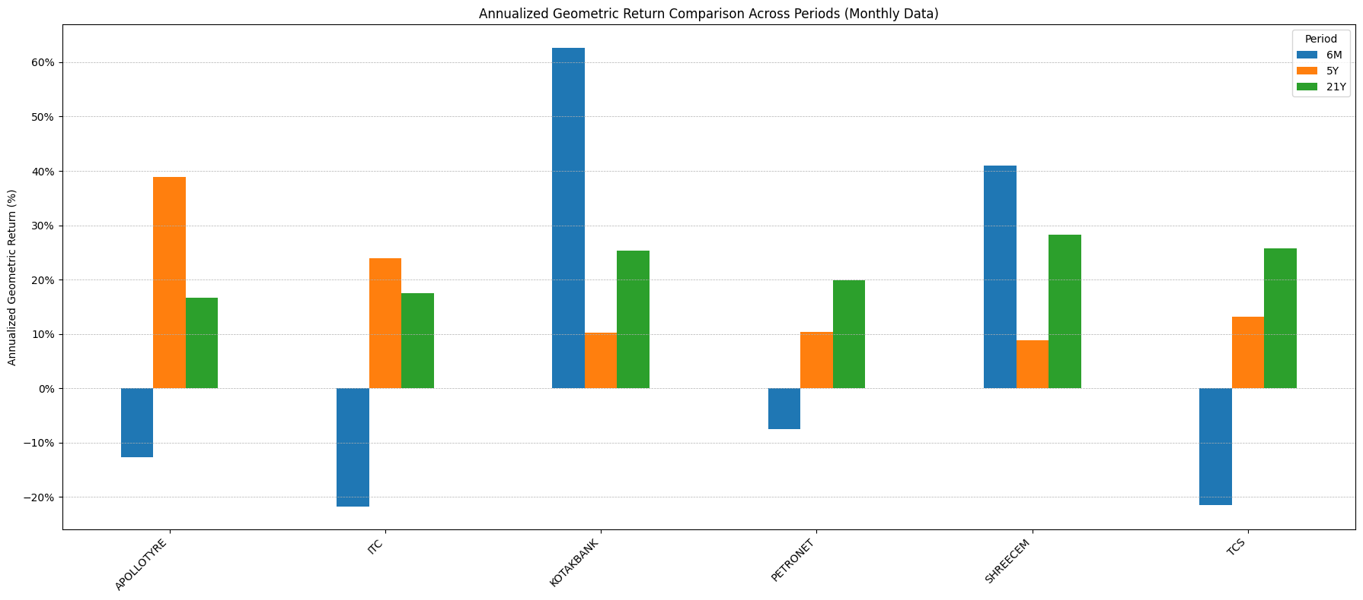
Stock Performance

Slide 8
Strategic Stock Selection – Combining Momentum & Reversal
Using both Momentum Persistence(6M outperformance) and Momentum Reversal(5Y underperformance), we select 6 stocks
Shortlisted Stocks:
APOLLOTYRE
ITC
KOTAKBANK
PETRONET
SHREECEM
TCS

Slide 9
Long-Term Performance & Volatility of Selected Stocks (21 Years)
Given your 20-year investment horizon, the 21-year historical data provides the most relevant context for long-term expectations.
Interpretation: Shree Cements and Kotak Bank have shown strong long-term arithmetic returns over 21 years, indicating consistent growth potential. Volatility varies, with Petronet LNG showing higher long-term volatility.
 | Period | Asset | Annual Geo Return (%) | Annual Arith Return (%) | Annual Vol (%) | Annual Sharpe
1 | 21Y | SHREECEM | 28.21% | 31.51% | 36.41% | 0.73
2 | 21Y | KOTAKBANK | 25.35% | 29.57% | 37.91% | 0.65
3 | 21Y | TCS | 25.76% | 28.14% | 35.04% | 0.66
4 | 21Y | PETRONET | 19.83% | 27.21% | 44.57% | 0.5
5 | 21Y | APOLLOTYRE | 16.73% | 24.79% | 42.60% | 0.46
6 | 21Y | ITC | 17.45% | 19.06% | 24.15% | 0.58

Slide 10
Diversification – Understanding Correlations
Correlation measures how much two stocks move in relation to each other. Lower correlation leads to better diversification
1-Year Correlation: Long-term correlations are generally low, indicating that combining these assets effectively diversifies risk over your 20-year horizon. For example, TCS shows relatively low correlation with most other stocks (e.g., 0.11 with APOLLOTYRE, 0.14 with ITC).
Long term Correlation (past 21 years)
Ticker | APOLLOTYRE | ITC | KOTAKBANK | PETRONET | SHREECEM | TCS
APOLLOTYRE | 1 | 0.38 | 0.47 | 0.31 | 0.45 | 0.11
ITC | 0.38 | 1 | 0.32 | 0.22 | 0.38 | 0.14
KOTAKBANK | 0.47 | 0.32 | 1 | 0.4 | 0.48 | 0.16
PETRONET | 0.31 | 0.22 | 0.4 | 1 | 0.4 | 0.13
SHREECEM | 0.45 | 0.38 | 0.48 | 0.4 | 1 | 0.13
TCS | 0.11 | 0.14 | 0.16 | 0.13 | 0.13 | 1

Slide 11
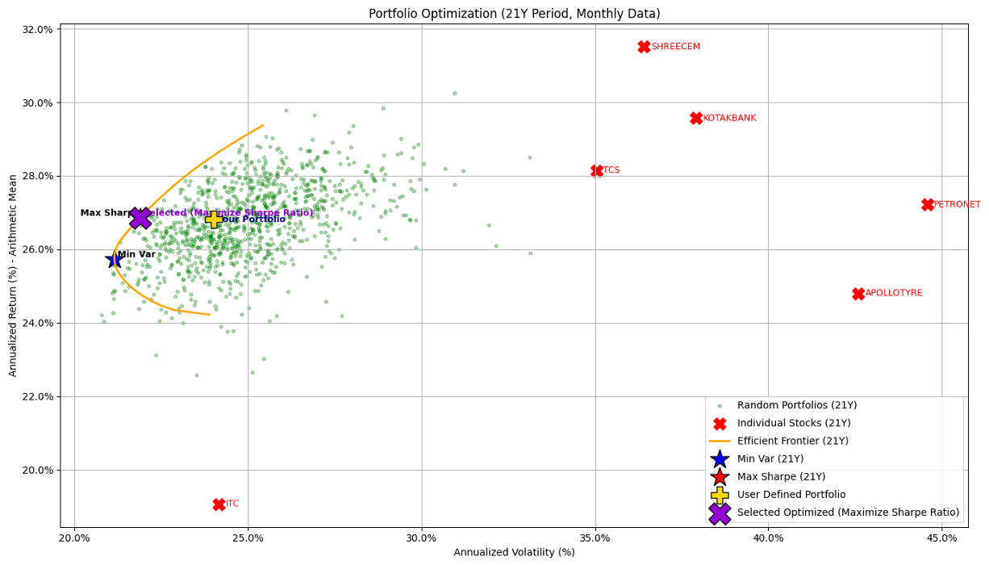
Portfolio Optimization – The Efficient Frontier
We applied Mean-Variance Optimization to generate efficient portfolios.

Slide 12
Portfolio Optimization – The Efficient Frontier
Interpretation:
The X-axis shows annualized volatility (risk), and the Y-axis shows annualized return.
Individual stocks (red 'X' marks) typically fall below the efficient frontier, demonstrating the benefits of diversification.
The orange curve (Efficient Frontier) represents the optimal portfolios where no better return can be achieved for the same risk, and vice versa.

Slide 13
Portfolio Recommendation 1 – Conservative Growth
Minimum Volatility Portfolio
Target Client: Prioritize minimizing risk while still seeking steady growth.
Metrics:
Annualized Return (Arithmetic Mean): 25.73%
Annualized Volatility (Risk): 21.14%
Sharpe Ratio: 0.98
Portfolio Weights:
APOLLOTYRE: 6.5%
ITC: 30.0%
KOTAKBANK: 10.87%
PETRONET: 9.11%
SHREECEM: 13.53%
TCS: 30.0%
Rationale: This portfolio provides the most stable growth path over the 20-year horizon, minimizing fluctuations while still delivering a competitive return.

Slide 14
Portfolio Recommendation 2: The "Balanced Growth" Option (Maximum Sharpe Ratio Portfolio)
Target Client: Prioritize minimizing risk while still seeking steady growth. This portfolio is considered the most "efficient", as it maximizes risk-adjusted returns
Metrics:
Annualized Return (Arithmetic Mean): 26.86%
Annualized Volatility (Risk): 21.88%
Sharpe Ratio: 1.00
Portfolio Weights:
APOLLOTYRE: 0.01%
ITC: 24.83%
KOTAKBANK: 14.53%
PETRONET: 6.22%
SHREECEM: 24.40%
TCS: 30.0%
Rationale: This portfolio offers the optimal balance, delivering the highest return for every unit of risk accepted. It's suitable for your high-risk tolerance as it focuses on efficiency.

Slide 15
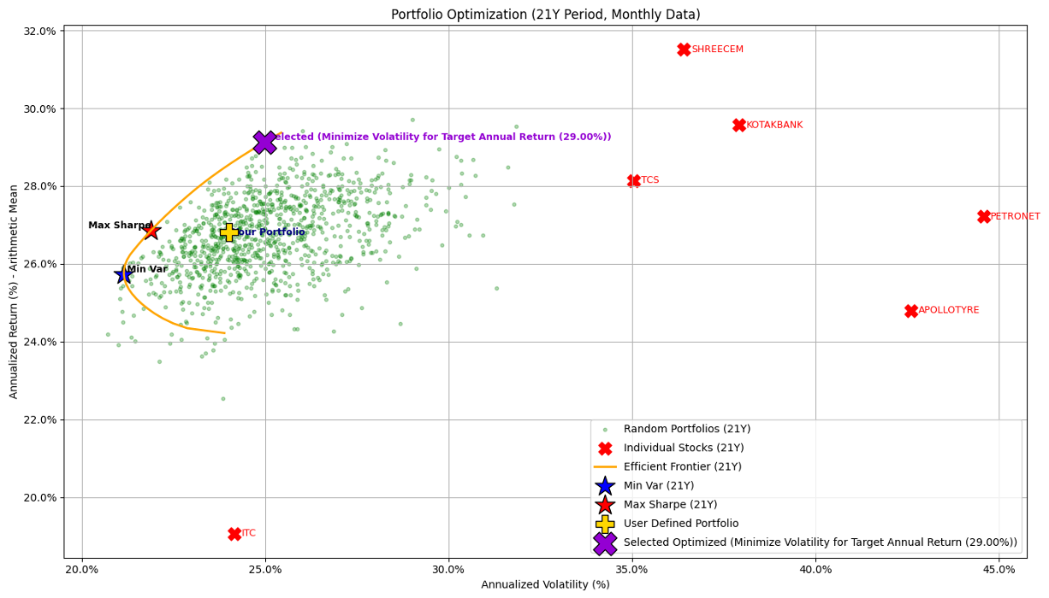
Portfolio Recommendation: Customizing for Your 28% Return Objective
Optimized for a Target Annual Return of 29.00% with minimum volatility.
This portfolio is designed to meet your stated goal of a high return for college fees.

Slide 16
Portfolio Recommendation: Customizing for Your 28% Return Objective
Metrics (21Y Period):
Annualized Return (Arithmetic Mean): 29.12%
Annualized Volatility (Risk): 24.97%
Sharpe Ratio: 0.97
Portfolio Weights:
APOLLOTYRE: 0%
ITC: 3.76%
KOTAKBANK: 27.47%
PETRONET: 8.77%
SHREECEM: 30.0%
TCS: 30.0%
Rationale: This portfolio is specifically tailored to aim for your stated return objective of 28% annually (achieving 29.12%), while ensuring we're taking the least amount of risk possible (24.97% volatility) to reach that goal.
This directly addresses your desire for high capital for college fees over 20 years by strategically allocating across assets with strong long-term growth potential.

Slide 17
Conclusion & Next Steps
Key Takeaways:
Strategic Stock Selection: Diversification, momentum and reversal strategies underpin robust long-term portfolios.
Optimized for Your Goal: Portfolio optimization tailors investments to your specific risk tolerance and return objectives.
Recommendation: Our optimized portfolio targeting 29.00% annual return is ideal for your 20-year college fund goal.
Annualized Return: 29.12%
Annualized Volatility: 24.97%
Sharpe Ratio: 0.97
Next Steps:
Review and discuss recommendations.
Finalize portfolio allocation.
Begin investment process.
Regularly review performance.

